Slide 1
BriteCore PoC Web API
https://britecore-poc-server-session.herokuapp.com/auth/login/
Use above link to access browsable Web API.
Username :- phil.reynolds (lower case) – Admin
Password :- poctest#1 (lower case)
Username :- editor (lower case) – Non Admin
Password :- test#123 (lower case)

Slide 2
AWS Lambda deployment
Created AWS RDS instance and Subnets via AWS console
AWS lambda deployment using Zappa as per instruction in GitHub repo.
https://2pprl7yzie.execute-api.ap-southeast-1.amazonaws.com/dev
Same credentials are used as mentioned in previous slide.
Caution as I have used Token based authentication in order to access API via UI. AWS deployment can not be easily tested via URL in plain browser as we need to piggy back token with each request after login.

Slide 3
Source code
https://github.com/MaheshBodas/britecore-poc-api-master

Slide 4
Unit testing.
Added test cases related for Post and Get action for RiskType and Risks.
Tested response for Admin and Non-admin users as API support role base authorization.
Made use of Design patterns to avoid duplication of code while writing test cases.

Slide 5
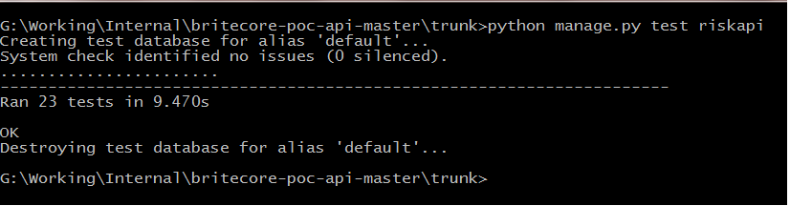

Slide 6
Salient features
Solution that allows insurers to define their own custom data model for their risks. There are no database tables called automobiles, houses, or prizes. Instead, insurers will be able to create their own risk types and attach as many different fields as they would like.
Fields are bits of data like first name, age, zip code, model, serial number, Coverage A limit, or prize dollar amount. Basically any data the carrier would want to collect about the risk. Fields can also be of different types, like text, date, number, currency, and so forth.

Slide 7
Salient features (continued)
As risk field types are user defined and not commited at time of table creation. Actual field/column value stored in table is string type. But field type sanctity is enforced using model validators. i.e User can not supply Date value where Currency is expected.
Uniqness among RiskType names is maintained by enforcing unique constrain. But enforcing unique risk field name in similar fashion is somewhat restrictive and naive. I have tried to maintain unique field name within Risk Types and not across all Risk Type using mode validators.

Slide 8
Salient features (continued)
During risk and risk field creation system checks that proper referential integrity is maintained among Risk Type and Risks. Risk Fields ensures that proper referential integrity is maintained with Risk Type and Risk Type fields.
Risk API allows users to create RiskTypes and associated RiskTypeFields in one go with use of nested serializer.
Risk API allows users to create Risk and associated RiskFields in one go with use of nested serializer.
Various model validation errors within RiskType and RiskTypeFields, Risk and RiskFields are returned to client of RiskAPI in JSON format.

Slide 9
Salient features (continued)
Risk and RiskFields carry extra metadata related to RiskType and RiskTypeFields.
On authentication front, only authenticated users can access RiskAPI. Role based authorization further enable only admin users to create/delete RiskType. Non admin users only have list and details option for RiskTypes. However they can create Risk instances based on RiskTypes.
Session authentication is used for browsable API that runs within same session that of Web API
Token authentication is used for seperate website that access Web API for retrieving and creating RiskTypes and Risk.

Slide 10
Salient features (continued)
Used Default router to list all available links and Pastebin docs and schema information also available for API.
One touch Heroku deploy button.

Slide 11
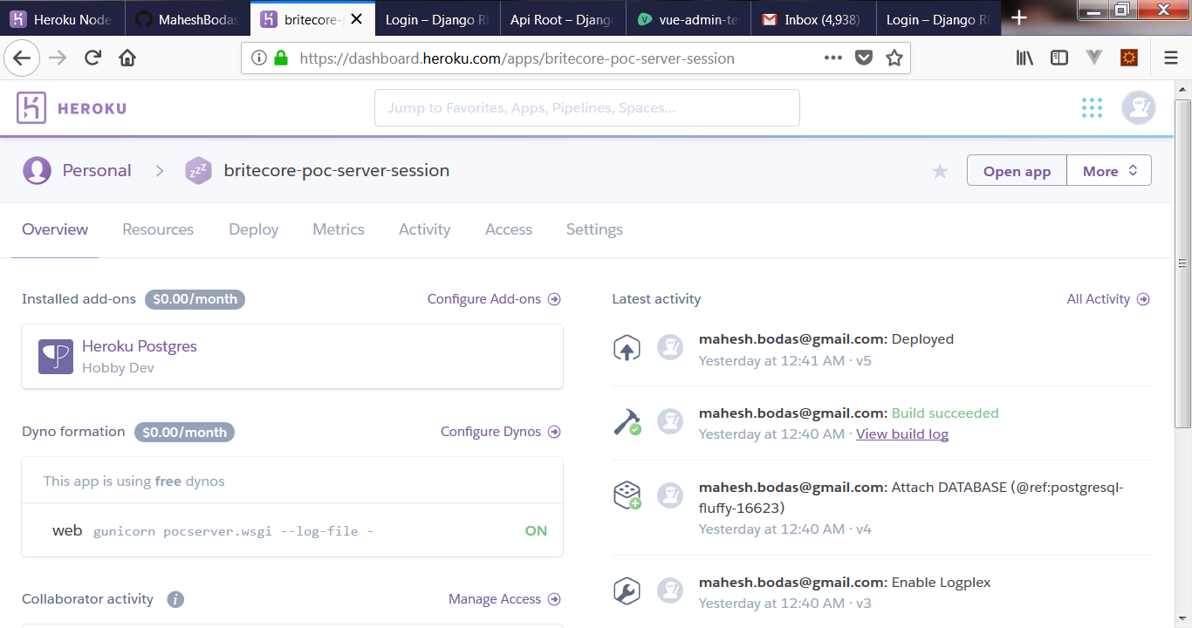
Screenshot Heroku deployment

Slide 12
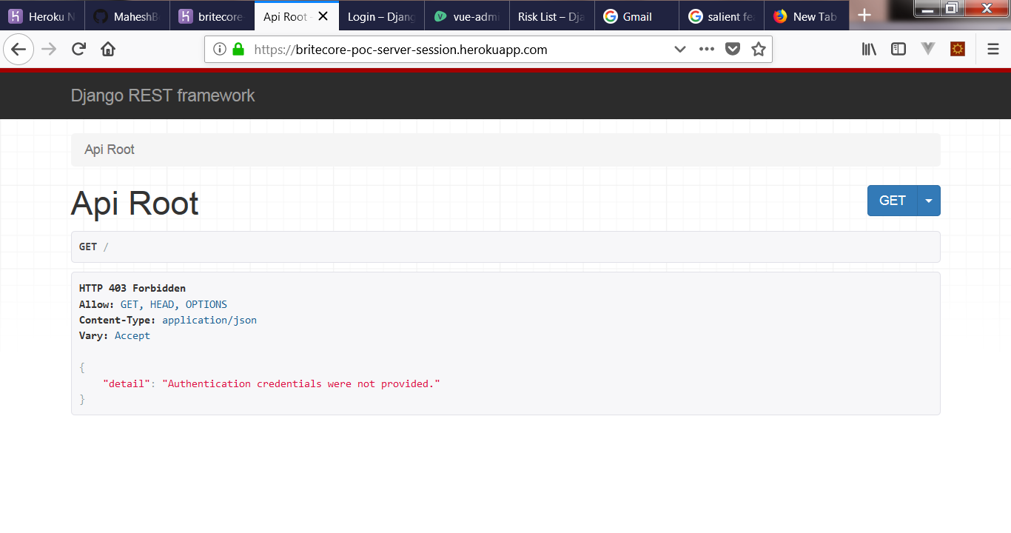
API response when not Logged In

Slide 13
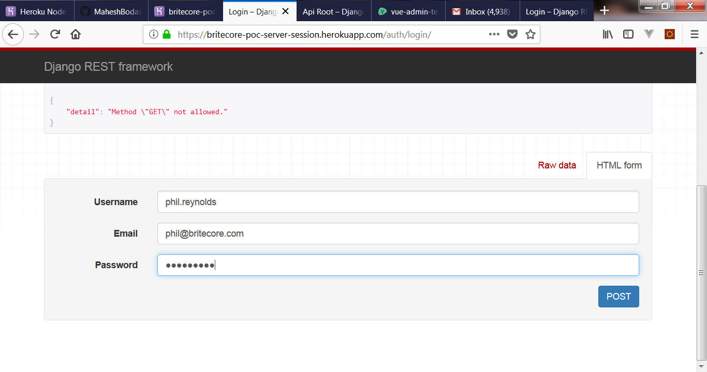
Enter credentials

Slide 14
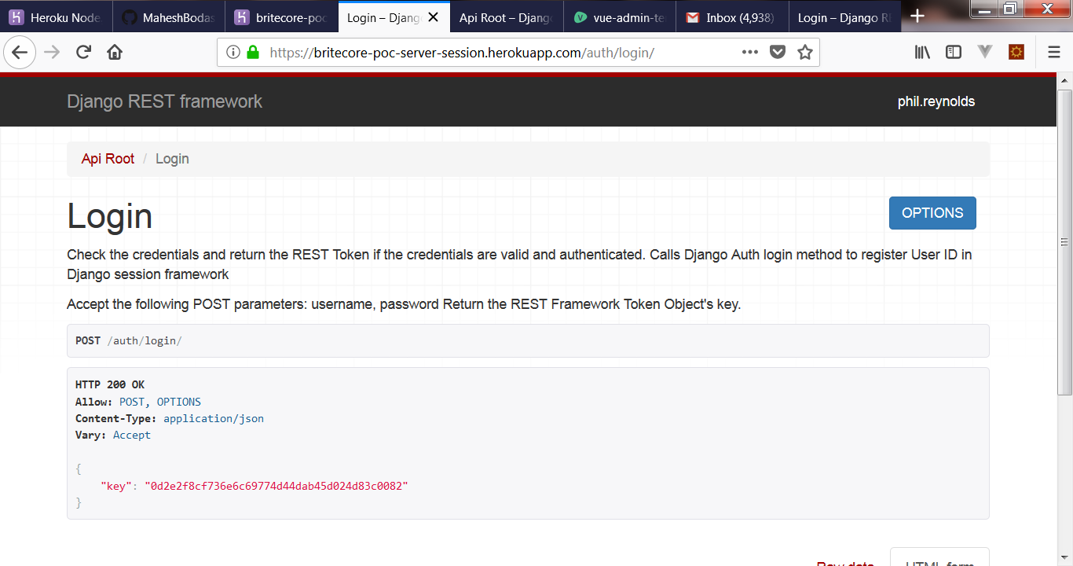
Successful Login

Slide 15
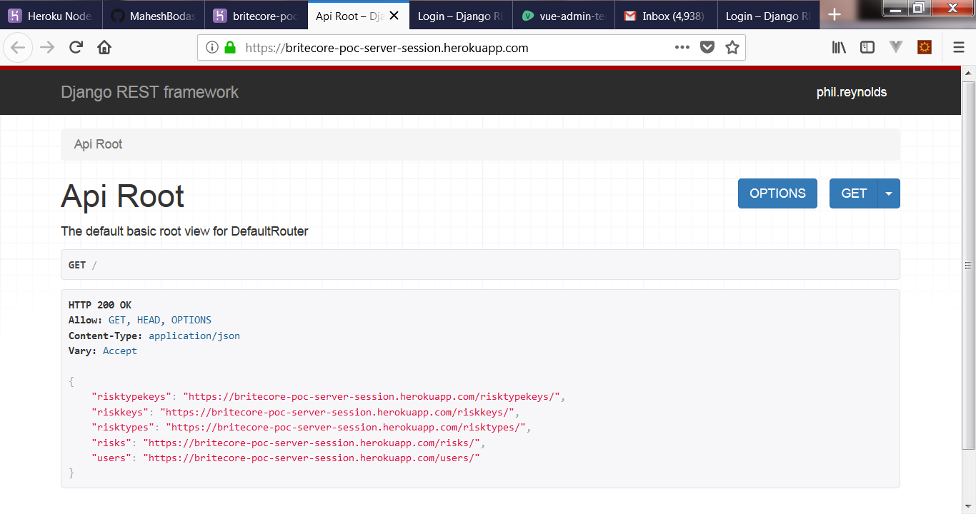
API Root shows Default Router

Slide 16
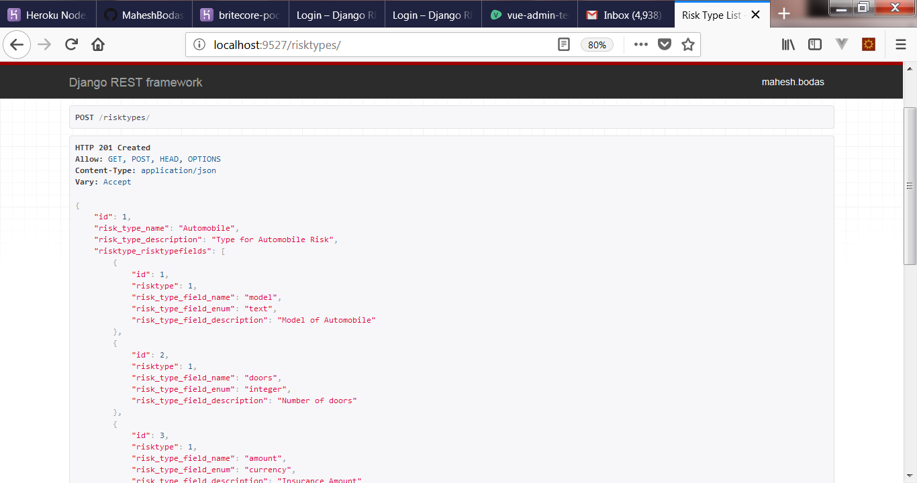
Posting RiskType successfully

Slide 17
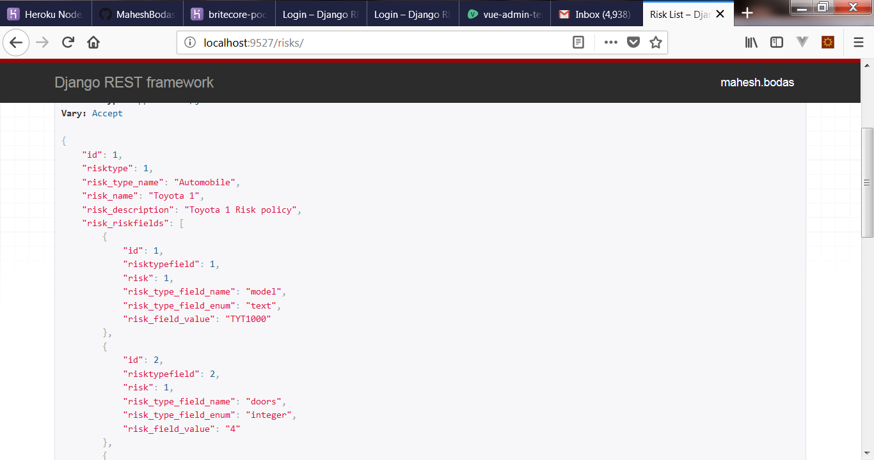
Posting Risk Instance

Slide 18
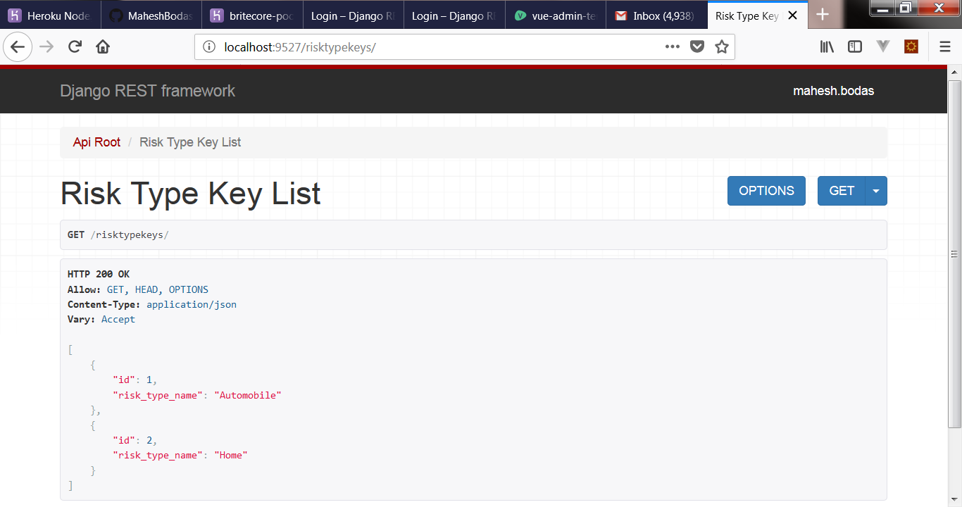
Get RiskTypeKeys

Slide 19
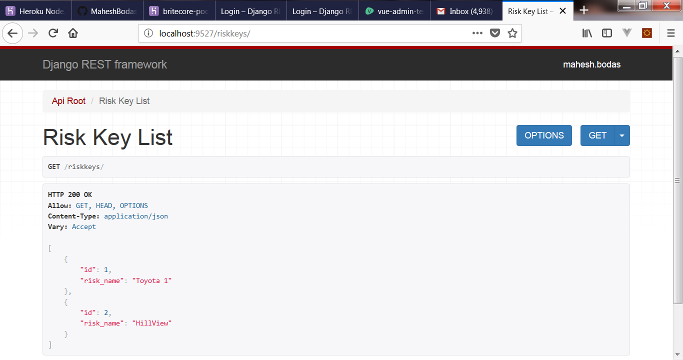
Get Risk Key List

Slide 20
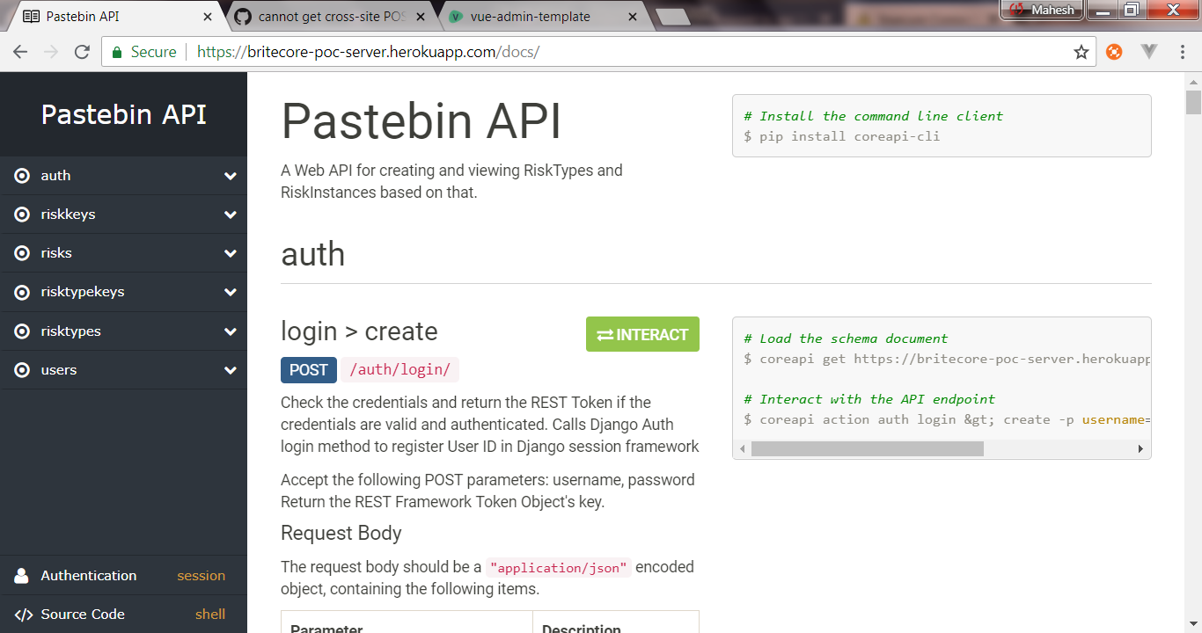
https://britecore-poc-server-session.herokuapp.com/docs/

Slide 21
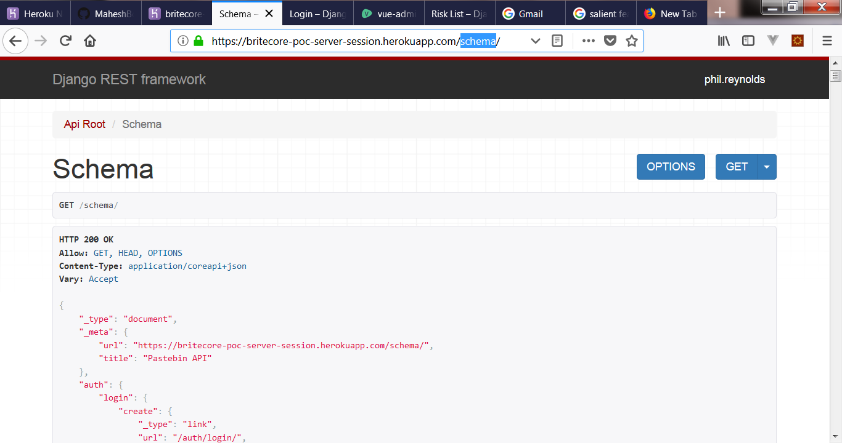
https://britecore-poc-server-session.herokuapp.com/schema /

